Slide 1
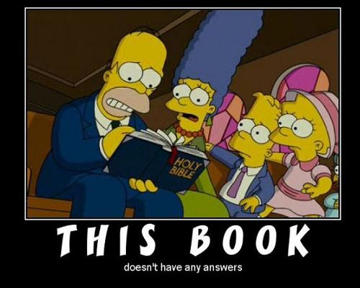
Accepting Ambivalence
Third Gender, Third Race, Third Space: Mysterious Transformations in Acts 8:26-40.

Slide 2
Acts 8:26-36
⁶ Now an angel of the Lord said to Philip, “Go south to the road—the desert road—that goes down from Jerusalem to Gaza.” ²⁷ So he started out, and on his way he met an Ethiopian^{[a]} eunuch, an important official in charge of all the treasury of the Kandake (which means “queen of the Ethiopians”). This man had gone to Jerusalem to worship, ²⁸ and on his way home was sitting in his chariot reading the Book of Isaiah the prophet. ²⁹ The Spirit told Philip, “Go to that chariot and stay near it.”
³⁰ Then Philip ran up to the chariot and heard the man reading Isaiah the prophet. “Do you understand what you are reading?” Philip asked.
³¹ “How can I,” he said, “unless someone explains it to me?” So he invited Philip to come up and sit with him.
³² This is the passage of Scripture the eunuch was reading:
“He was led like a sheep to the slaughter, and as a lamb before its shearer is silent, so he did not open his mouth. ³³ In his humiliation he was deprived of justice. Who can speak of his descendants? For his life was taken from the earth.”^{[b]}
³⁴ The eunuch asked Philip, “Tell me, please, who is the prophet talking about, himself or someone else?” ³⁵ Then Philip began with that very passage of Scripture and told him the good news about Jesus.
³⁶ As they traveled along the road, they came to some water and the eunuch said, “Look, here is water. What can stand in the way of my being baptized?” ^{[37] [c]} ³⁸ And he gave orders to stop the chariot. Then both Philip and the eunuch went down into the water and Philip baptized him. ³⁹ When they came up out of the water, the Spirit of the Lord suddenly took Philip away, and the eunuch did not see him again, but went on his way rejoicing. ⁴⁰ Philip, however, appeared at Azotus and traveled about, preaching the gospel in all the towns until he reached Caesarea

Slide 3
Third Race

Slide 4
Liminal Race
The text tells us that the Eunuch an ‘Ethiopian’ (Αΐθίοψ) is an official who has journeyed to Jerusalem to worship and is now returning to Ethiopia.
Greco-Roman authors viewed Ethiopia as a liminal nation given itself relation to the Mediterranean world and the larger Roman Empire.
Luke’s identification of the eunuch as an Ethiopian brings the liminality of his gender into a sharper focus.

Slide 5
All Roads Lead Out of Rome
For its inhabitants, Rome was the center of the empire and coterminous with the known world.
The Gospel placed in the center of the empire is placed by the author of Luke to be in the perfect position to take it to the ends of the earth.
For the ancient Greeks and Romans “the ends of the earth” was best represented by “Ethiopia.”

Slide 6
Outsider No Matter What!
Among those writing in the Greco-Roman world, Ethiopians represent the consummate outsider: that is, the non-Roman, the non-Greek, and even the non-Jew
Ethiopians as members of a utopian world who have attributes typically ascribed to all utopian peoples, including innocence, love of freedom, military prowess, wealth, wisdom, longevity, attractiveness, semi-divine tallness of stature and piety.
Greek and Roman authors often identify Ethiopians as an uncivilized, 'barbaric’ and at times monstrous people

Slide 7
Gender Transgressors
‘Ethiopian’ (Αΐθίοψ) literally meant 'burnt face’ and denoted a person with dark skin who was somatically different from the majority of people living in the Roman Empire.
Also reflects wider assumptions concerning the negative color symbolism of dark skin.
Greek and Roman authors often portrayed 'barbarians’ in general as gender transgressors, typically expressed in terms of male effeminacy or female masculinity

Slide 8
Sebasteion at Aphrodisias

Slide 9
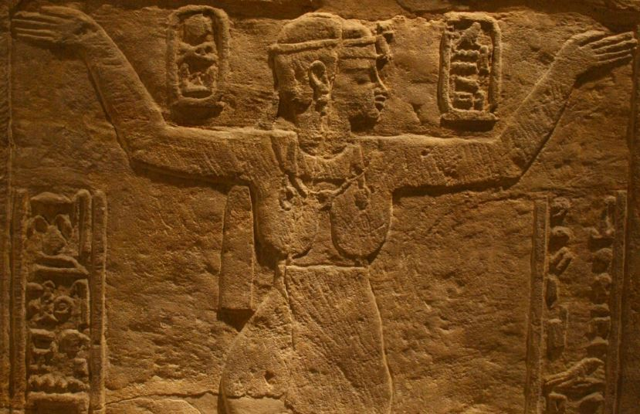
Transgressive Roles
Greek and Roman authors also maintained that female rule was a further sign of the effeminacy of ‘other’ nations.
Greek and Roman authors often depicted ‘foreign’ queens in a negative light.
Like Cleopatra, the queens of Ethiopia (who were known by the title ‘Candace’) were also depicted as wealthy women who donned the masculine role of political and military rule.

Slide 10
Third Gender

Slide 11
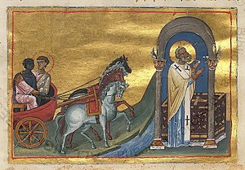
Eunuchs in the Greco-Roman World
Luke introduces the eunuch by bestowing them with an unusual amount of narrative detail, saying:
'Behold! An Ethiopian eunuch, an official of Candace, queen of the Ethiopians, in charge of her entire treasury’ (8.27)

Slide 12
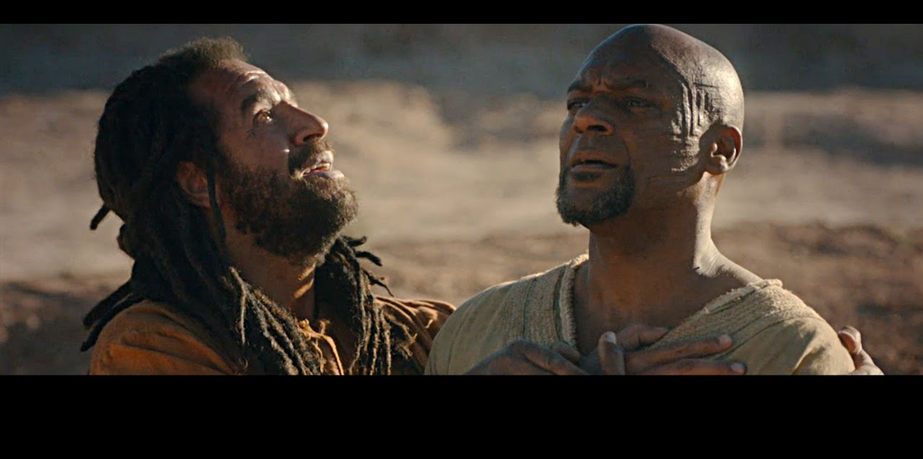
ό εύνοΰχος
Some scholars claim that the eunuch’s dominant designation as a ‘eunuch’ does not imply that this person as a castrated male.
the term ‘eunuch’ (εύνοΰχος) does not necessarily convey the sense of a 'physical eunuch’, so the argument goes, but rather a 'court official.

Slide 13
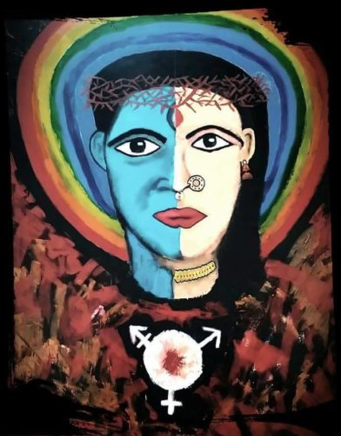
Hybrid or Monstrous?
Philo 2.184
Neither Man nor Woman
Lucian Eunuch 6
on this account I, the butler of Pharaoh, who exerts his stiff-necked, and in all respects intemperate reason, in the direction of indulgences of his passions, am a eunuch, having had all the generative parts of my soul removed, and being compelled to migrate from the apartments of the men, and am a fugitive also from the women's chambers, inasmuch as I am neither male nor female; nor am I able to disseminate seed nor to receive it, being of an ambiguous nature, neither one thing nor the other; a mere false coin of human money, destitute of immortality, which is from time to time kept alive by the constant succession of children and offspring: being also excluded from the assembly and sacred meeting of the people, for it is expressly forbidden that any one who has suffered any injury or mutilation such as I have should enter in Thereto.
“a eunuch was neither man nor woman but something composite, hybrid and monstrous, outside of human nature.”

Slide 14
Leviticus 17:21-23
¹⁷ Speak unto Aaron, saying, Whosoever he be of thy seed throughout their generations that hath a blemish, let him not approach to offer the bread of his God. ¹⁸ For whatsoever man he be that hath a blemish, he shall not approach: a blind man, or a lame, or he that hath a ^{[a]}flat nose, or anything superfluous, ¹⁹ or a man that is broken-footed, or broken-handed, ²⁰ or crook-backed, or a dwarf, or that hath a blemish in his eye, or is scurvy, or scabbed, or hath his stones broken; ²¹ no man of the seed of Aaron the priest, that hath a blemish, shall come nigh to offer the offerings of Jehovah made by fire: he hath a blemish; he shall not come nigh to offer the bread of his God. ²² He shall eat the bread of his God, both of the most holy, and of the holy: ²³ only he shall not go in unto the veil, nor come nigh unto the altar, because he hath a blemish; that he profane not my sanctuaries: for I am Jehovah who sanctifieth them.

Slide 15
Deut 23:1
He that is wounded in the stones, or hath his privy member cut off, shall not enter into the assembly of Jehovah.
² A bastard shall not enter into the assembly of Jehovah; even to the tenth generation shall none of his enter into the assembly of Jehovah.
³ An Ammonite or a Moabite shall not enter into the assembly of Jehovah; even to the tenth generation shall none belonging to them enter into the assembly of Jehovah for ever:

Slide 16
Third Space

Slide 17
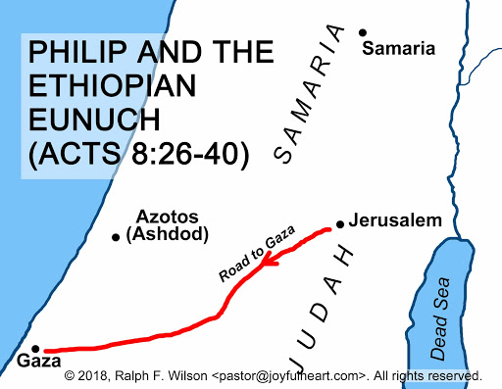
Wilderness
The road itself is designated as έρημος, meaning ‘wilderness,’ ‘desert’ or ‘deserted’ (v. 26).
This wilderness is in the middle of nowhere and between two definite points, Jerusalem and Gaza.

Slide 18
Textual Variants
King James Version
New Revised Standard Version
Revised Standard Version
³⁶ As they went along the road they came to some water; and the eunuch *said, “Look! Water! What prevents me from being baptized?” ³⁷ [^{[a]}And Philip said, “If you believe with all your heart, you may.” And he answered and said, “I believe that Jesus Christ is the Son of God.”] ³⁸ And he ordered the ^{[b]}chariot to stop; and they both went down into the water, Philip as well as the eunuch, and he baptized him.
KJV
³⁶ As they traveled along the road, they came to some water and the eunuch said, “Look, here is water. What can stand in the way of my being baptized?” ^{[37] [c]} ³⁸ And he gave orders to stop the chariot. Then both Philip and the eunuch went down into the water and Philip baptized him.
³⁶ And as they went along the road they came to some water, and the eunuch said, “See, here is water! What is to prevent my being baptized?”^{[a]} ³⁸ And he commanded the chariot to stop, and they both went down into the water, Philip and the eunuch, and he baptized him. ³⁹ And when they came up out of the water, the Spirit of the Lord caught up Philip; and the eunuch saw him no more, and went on his way rejoicing.

Slide 19
Acts 8:26-40 Who Saves Whom???

Slide 21
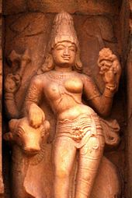
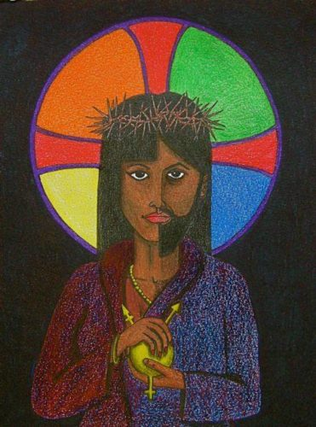
Thank You
Dr. Sharon Jacob
Assistant Professor of New Testament
Pacific School of Religion

